Slide 1
…

Slide 2
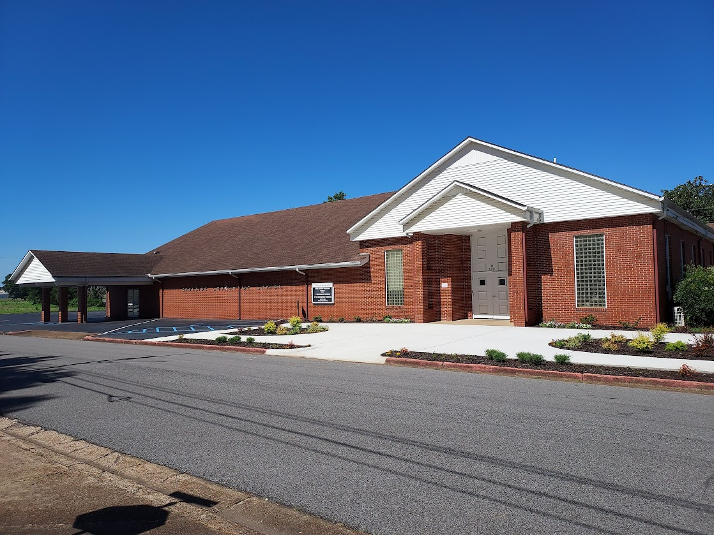

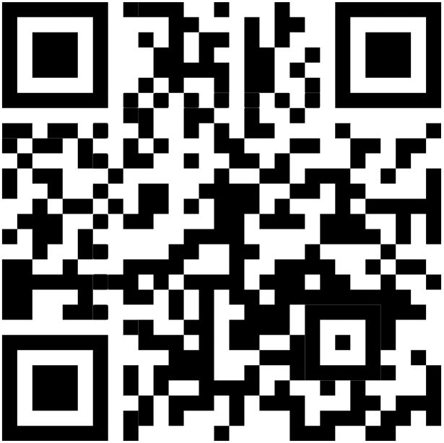
Welcome
Services will begin in:
WELCOME VISITORS
Please scan the QR code to allow us to have a record of your visit
www.eastside-church.com/welcome

Slide 3

Auditorium
The Growth and Development of the New Testament Church
Eastside Curriculum – Qtr 14 (Nov. 2025 – Jan. 2026)

Slide 4
Acts 27 – Faith, Trust, and Commitment

Slide 5
Around A.D. 56-57 while Paul was in Corinth during his third journey he wrote the letter to the Romans expressing his desire to come to them if God wills (Romans 1:10). At the time the letter was written, the church in Rome had already been established for many years (Romans 1:8). Now, at the end of his third journey in Acts 21, Paul finds himself arrested in Jerusalem as was prophesied earlier in the chapter. As Paul does often, he defends himself and his actions to the mob, and the council (Acts 22 & 23). Then in Acts 23:11 while Paul is being held in the barracks by the Romans, God makes a promise to him. He encourages Paul to be of good cheer, telling him you must also bear witness at Rome. Paul never fails to believe in that promise.
Two years pass as Paul waits in prison not knowing when he would leave for Rome (Acts 24). Through all of this he continued to fulfill his mission of preaching the gospel. In Acts 25 & 26 he is given the opportunity to present the gospel to King Agrippa fulfilling the prophecy that Jesus spoke in Acts 9:15 that he would carry Jesus’ name to kings. Paul presents a compelling speech to the king only to hear his reply, “you almost persuade me to become a Christian”. Through all of this Paul leaves the logistics and timing for his trip to Rome up to God.

Slide 6
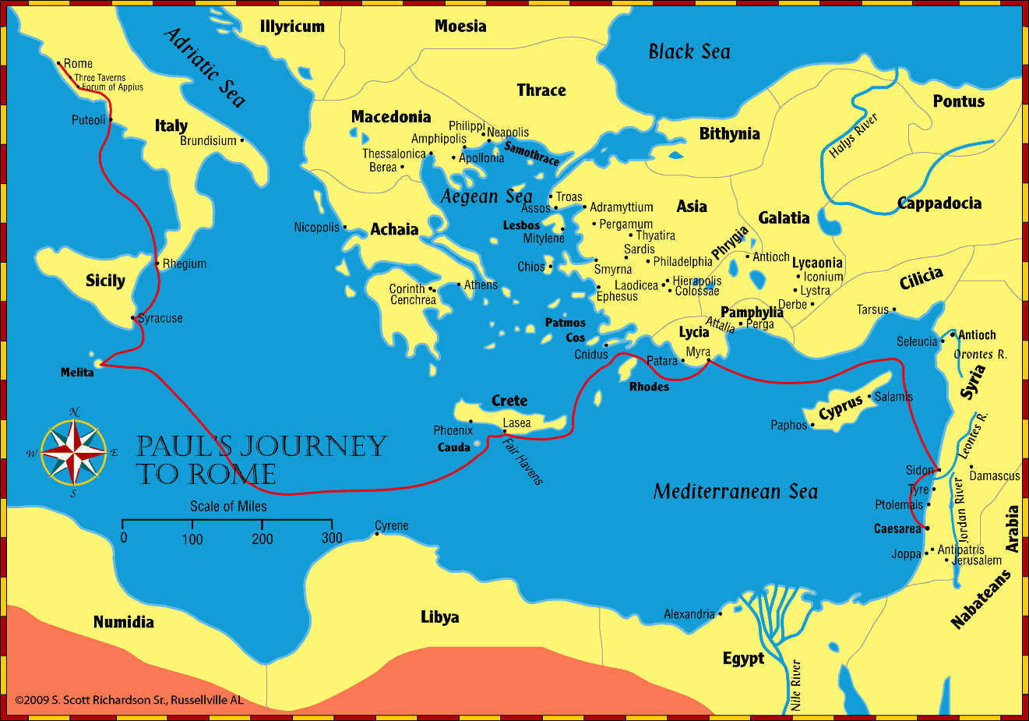
1. They board a ship and put out to sea.
2. Next day they land at Sidon.
3. Sailed to Myra. Changed to Alexandrian ship headed for Italy.
4. After several days they arrive at Cnidus.
5. Difficulty sailing to Fair Havens.
6. Leave Fair Havens to sail to Phoenix. Violent storm batters the ship and sail under Clauda. 14 days at sea.
4
7
6
3
2
5
7. Ship is shattered on the rocks. They all escape safely to land.
1

Slide 7
Lessons:
God’s promises never fail – In His Time
Keep your eye on the goal
Trust in God – He is in control
Must be obedient to His will – “Do it God’s way”
Never quit sowing the seed

Slide 8
1)
2)
3)
4)
5)
6)
7)
8)
9)
10)
11)
12)
13)
14)
15)
Ascension & Appointment
Philippian Prison
16)
17)
18)
19)
20)
21)
22)
23)
24)
25)
26)
27)
28)
Pentecost & Peter’s Preaching
Addressing Athens
Lame Man & Lesson
Achaia, Antioch, & Apollos
Restrained, Released, & Request
Re-baptism, Repentance, & Riot
Deception & Detention
Macedonia & Miletus
Seven Selected
Jerusalem & Jewish Mob
Stephen Stoned
Review & Rejection
Samaria & Salvation
Council & Conspiracy
Saul Saved & Dorcas Delivered
Caesarean Confinement
Cornelius Converted
Appeal & Agrippa
Report & Relief
A
Review & Ridicule
Persecution, Peter, & Pride
Marooned On Malta
CTS
Antioch to Iconium
F
Rescued To Rome
Iconium to Antioch
ACTS
Disagreement & Decision
Alliteration Memory Statements To Help Recall Chapter Content
Notes:
Reference the Alliteration memory statements available for individual study of Acts and a means of helping each of us better study the book of Acts

